Slide 1

Little Miami High School
Freshman Orientation
Class of 2027

Slide 2
Introductions
Administrators:
Dr. Cathy Trevathan, Principal
Dr. Kevin Harleman, Assistant Principal
Dr. Chad Huelsman, Assistant Principal
Academic / Career Counselors: Student Support Counselors:
Miss Ashley Brown (A-D) Ms. Meredith Reuscher
Mrs. Elizabeth Yazell (E-K) Mrs. Amy Anderson
Mr. Todd Barnhart (L-R) Dr. Mary Kamphaus
Mrs. Brandy Stith (S-Z) Beech Acres Support Services

Slide 3

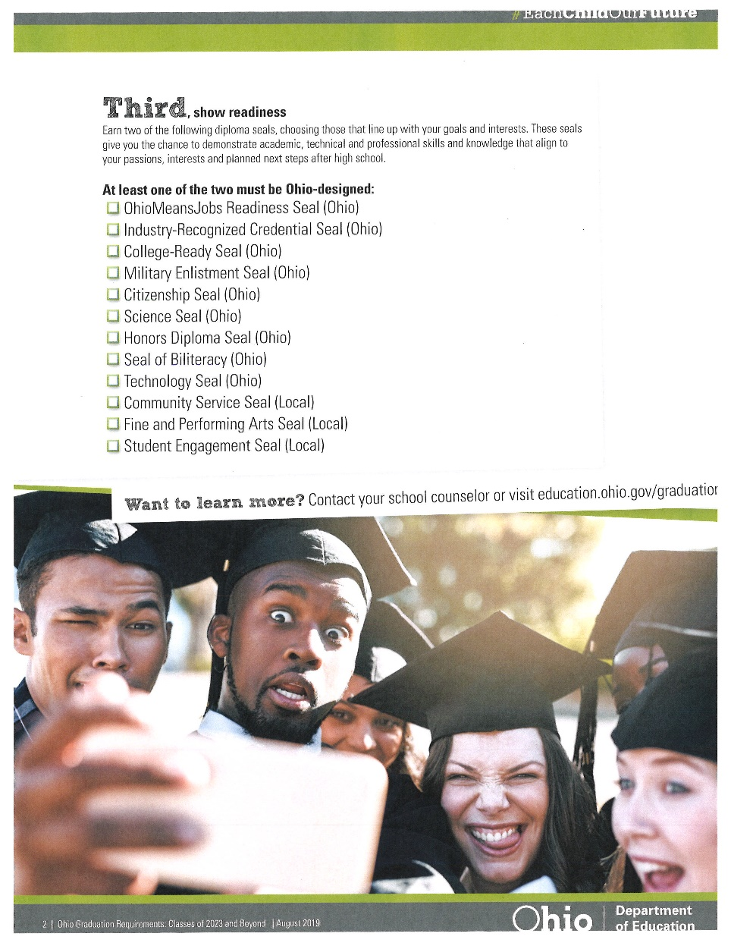
New Requirements for Graduation

Slide 4
Credits Required for Graduation
English: 4 credits
Math: 4 credits (Algebra 2)
Science: 3 credits (Physical Science, Biology, Advanced)
Social Studies: 3 credits (World History, American History, American Government/Economics)
Financial Literacy ½ credit
Health: ½ credit
Physical Education: ½ credit
Fine Arts: 1 credit
Electives: 4 credits
TOTAL = 20.5 credits

Slide 5
Athletic Eligibility
Must pass 5 one credit classes per year
  PE CLASSES DO NOT COUNT
Eligibility checks done weekly
Each sport will cost $225 during the 2023-24 school year
(For multiple sports and multiple family athletes contact Mr. Louis)
For Athletic Eligibility questions, please contact:
Mr. Matt Louis, Athletic Director
mlouis@lmsdoh.org

Slide 6
Honors Diploma Requirements
Must earn all but ONE of the following:
English: 4 credits
Math: 4 credits (Algebra I, Geometry, Algebra 2)
Science: 4 credits (Physical Science, Biology, Two Advanced Sciences)
Social Studies: 4 credits
Foreign Language: 3 credits in same language or (2-2)
Fine Arts: 1 credit
Grade Point Average: 3.5+ (unweighted)
ACT / SAT: 27+ / 1280+

Slide 7
Weighted Classes
Honors, Advanced Placement (AP)
  .05 added to GPA for passing grades per semester
College Credit Plus (CC+) courses
  .05 or .10 added to GPA for passing grades per semester that is equivalent to weighted courses at the high school.
  Classes 2 credit hours or less = .05
  Classes 3 credit hours or more = .10

Slide 8
College Recommended Courses
4 years of English
4 years of Math
4 years of Science
3 years of Social Studies
2-3 years of Foreign Language
1 year of Fine Arts

Slide 9

Required Courses for 9th grade
English 9 or Honors English 9
Math: Algebra 1, Geometry, Algebra 2, Honors Algebra 1, Honors Geometry, or Honors Algebra 2
Science: Physical Science or Honors Biology
Social Studies: World History, Honors World History, AP European History
Physical Education

Slide 10
Physical Education Requirement
Physical Education (full year)
Summer School PE (Virtual):
Application and Fee required ($105/Session)
  Session 1: May 30-June 14 (12 days)
  Session 2: June 15-June 30 (12 days)
P.E. Option
  MUST complete two full seasons of a sport
  CANNOT combine P.E. classes and a sport
  MUST be OHSAA sanctioned and offered at LMHS
  MUST complete two full years of Marching Band
Air Force JROTC – 2 years
Kinesiology and Fitness DOES NOT COUNT

Slide 11
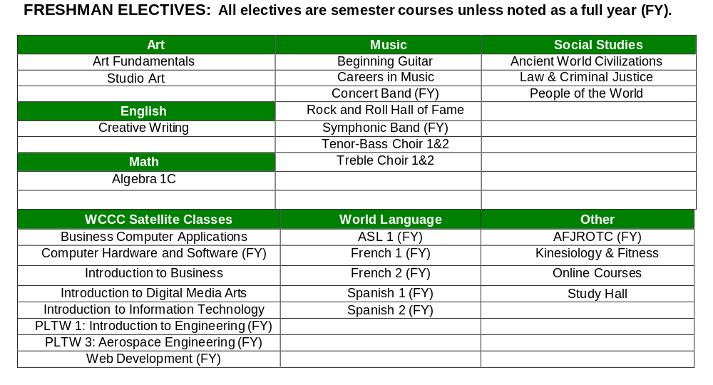
Elective Options

Slide 12
Online Elective Courses
Course descriptions are listed in the Little Miami course guide
Course fee is pending, but will be between $280-$560 per semester class
Course taken during school day

Slide 13
Scheduling Process: In-Person Students
All registration forms are due Friday, February 24, 2023 to LMMS social studies teachers.
Counselors will meet with students individually on March 2 and March 3 at LMMS.
During these meetings, students will receive Override forms, Online elective class forms, and Summer PE forms.
On March 6 all Override and Online elective class forms are due.

Slide 14
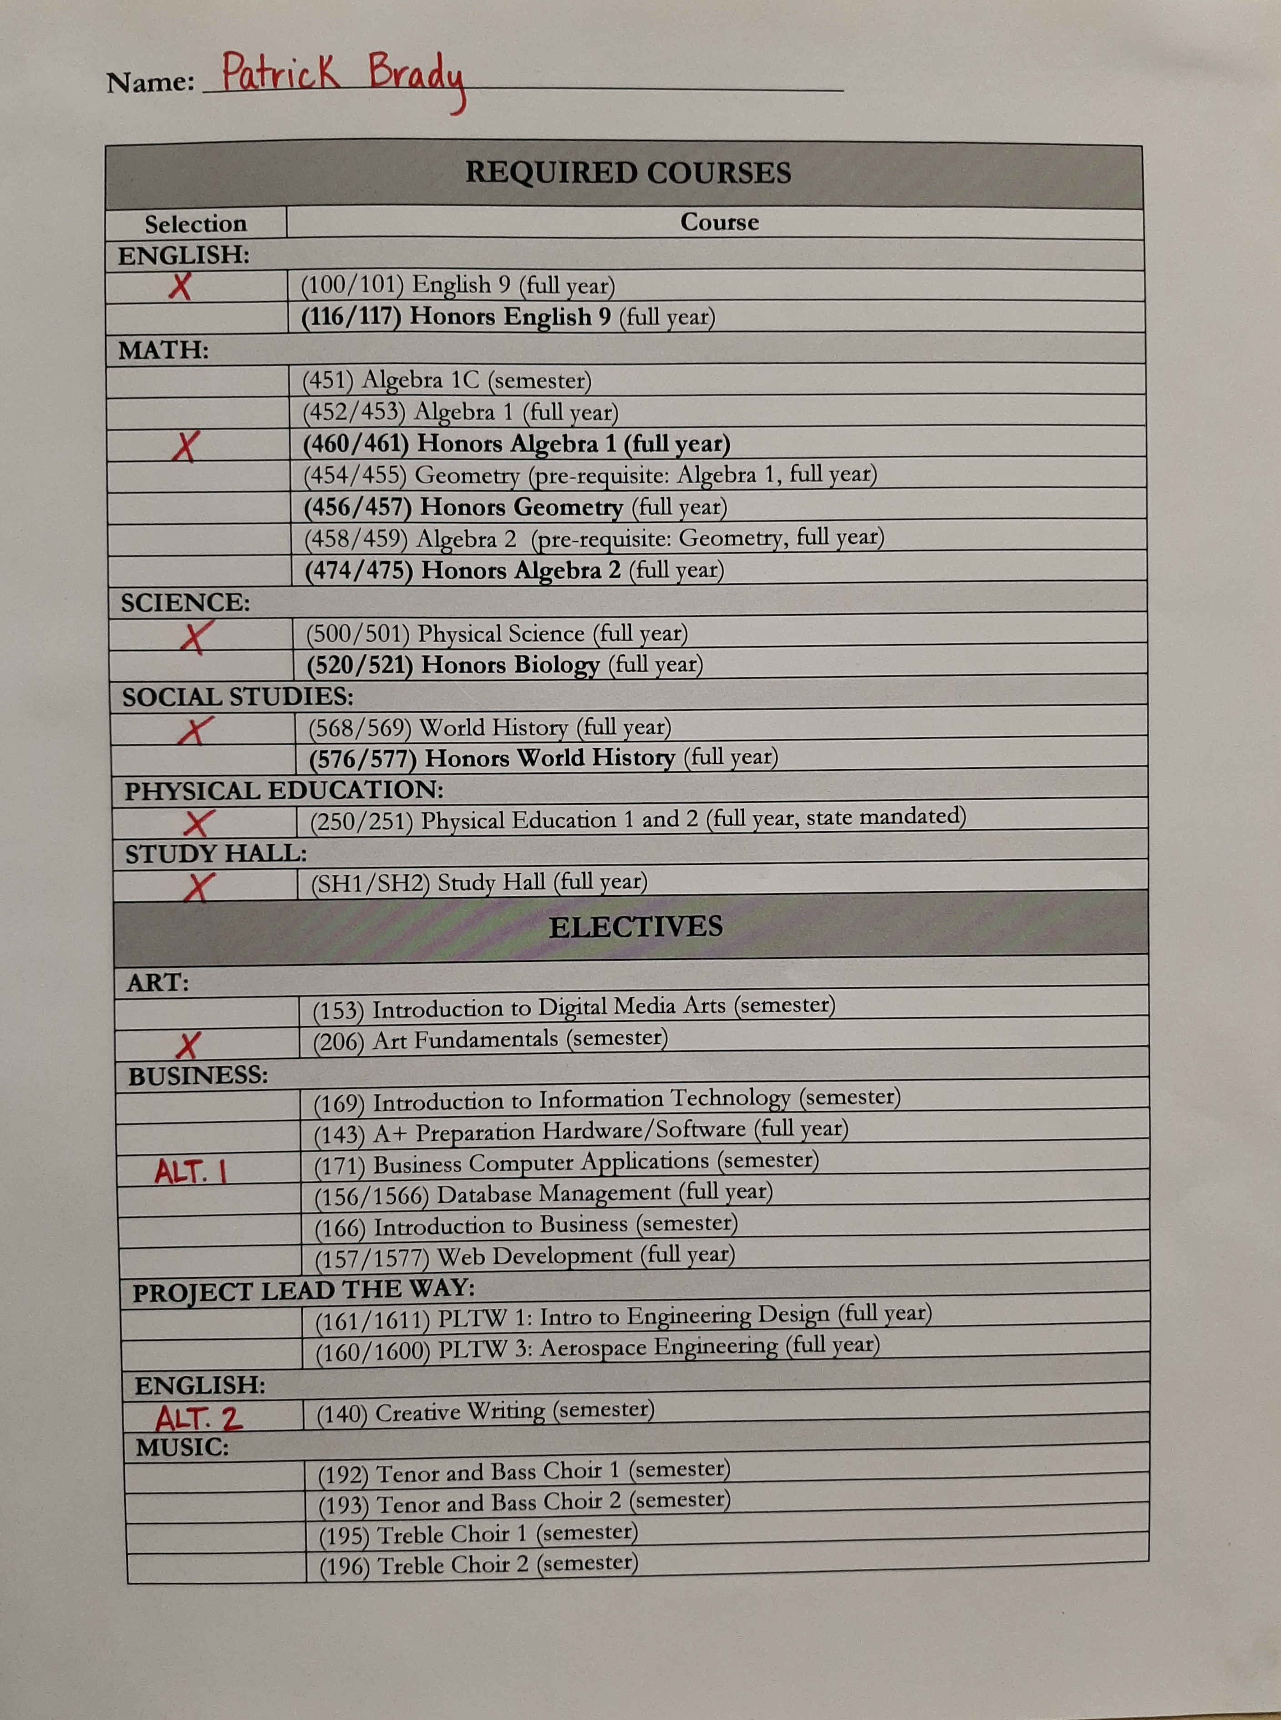
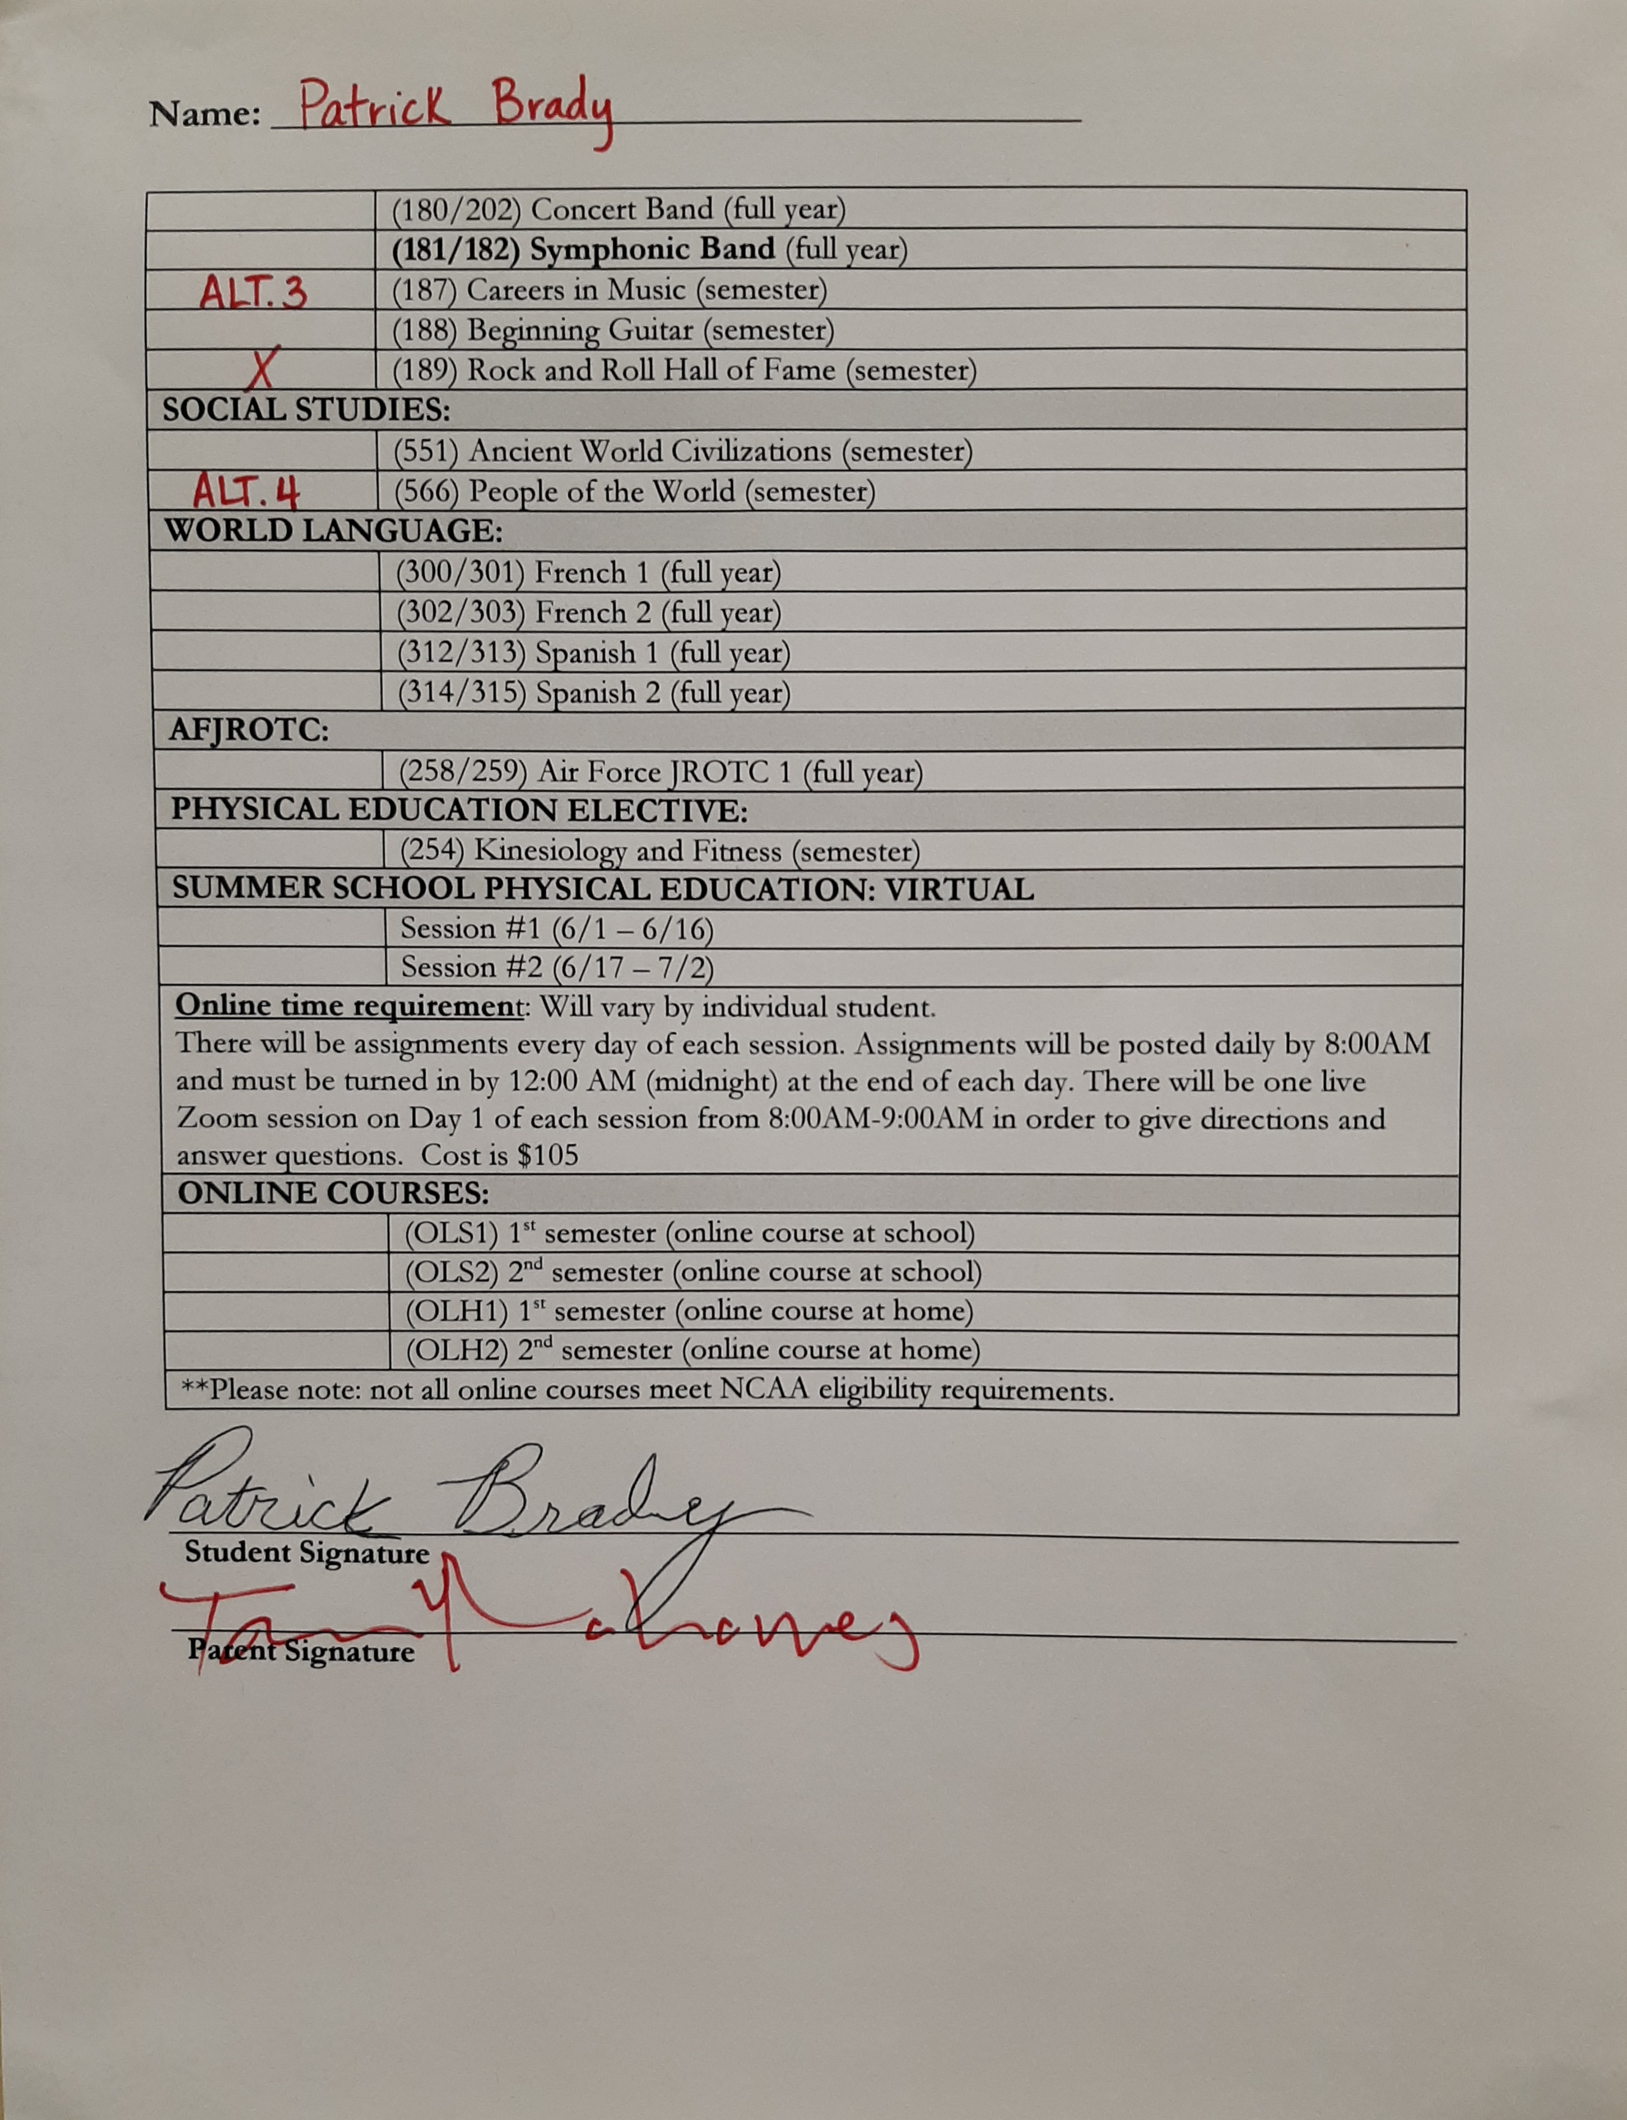
Example Registration Form

Slide 15
Schedule Changes
Student will have five days in the beginning of each semester to change semester-long elective courses.
Class selections will be final at the conclusion of the spring semester, prior to the start of the new school year. If a yearlong course is dropped after 5/25/23, the student will receive a Withdrawal/Fail on the transcript.

Slide 16
Counselor Contact Information
Miss Ashley Brown (A-D)
abrown@lmsdoh.org
Mrs. Elizabeth Yazell (E-K)
eyazell@lmsdoh.org
Mr. Todd Barnhart (L-R)
tbarnhart@lmsdoh.org
Ms. Brandy Stith (S-Z)
bphillips@lmsdoh.org

